Slide 1

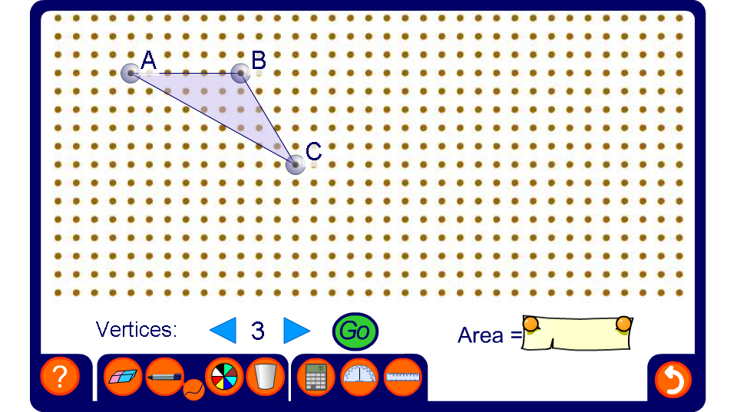


Finding the area of irregular polygons
Notes:
Drag the vertices to modify the shape. Ask a volunteer to divide the shape into rectangles and triangles using the pen tool set to draw straight lines. Use this to work out the area.
Alternatively, a rectangle could be drawn around the outside of the shape and the area found by subtraction.
As an extension ask pupils how we could find the perimeter of the given shape (using trigonometry).

